Slide 1
Harnessing Interfaces: Build Your Own Sales Price Engine

Slide 2


Speakers
Started working with Navision Attain 3.01 (in 2002)
Certified Navision Development on 3.10 (Full Day Test – 3.5” Floppy)
Wrote Web API Interface to XML Ports in NAV 4.0 (via MSMQ)
Developed in C/AL & AL
Industry Experience: Manufacturing, Food & Beverage, Retail, Not for Profit
Markets Served: Canada, United States, Mexico, New Zealand, Australia & UK
Based in Seattle, Washington
Email: jeff.landeen@rsmus.com
Jeff Landeen

Slide 3


Speakers
C/AL and AL developer for Dynamics NAV and Business Central (2014 onward)
MVP for Business Applications (2023-2024)
Worked as NAV/BC Developer/Technical Architect/Supervisor for Canadian and US Microsoft Partners and ISVs.
Based in Tampa, FL
Email: silviu.virlan@rsmus.com​
Blogsite: www.svirlan.com
Silviu Virlan – RSM US
Microsoft MVP

Slide 4
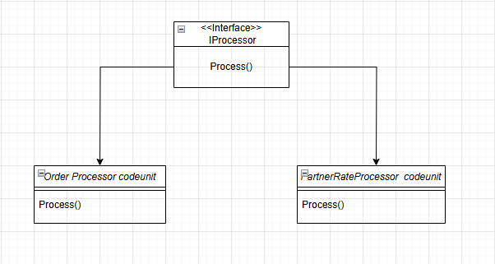
Interfaces in AL
What are interfaces?
Syntactical contract containing a set of methods without providing any implementation.
Different codeunits implementing the interface MUST implement these methods
Benefits
Clear “contract” of methods
Provides a layer of abstraction
No change to calling code
Minimal subscribers needed
Native to BC from version 16
Easier to upgrade
Notes:
JEFF
Interface is like a codeunit with a number of Procedures (i.e. “Methods”) that must be included in any implementation
Calling code & executing code have an agreed communication contract (the interface)
Provides a layer of abstraction
Do NOT need to change the calling code or subscribe to event publishers (Polymorphisim)
“Syntactical Contract” => if you don’t respect the interface signature then you will get a compile error

Slide 5
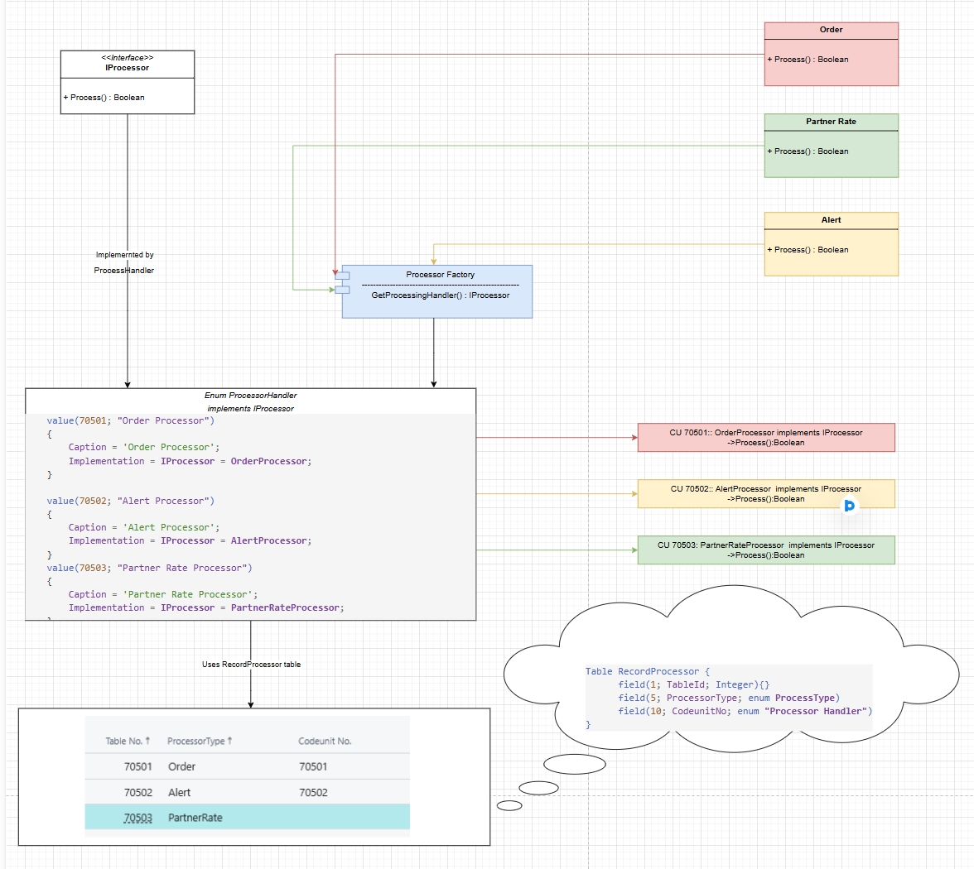
Custom interface implementation
Custom IProcessor interface implemented by 3 entities
Notes:
SILVIU
A few words about diagram:
Start by showing from the top right 3 pages all containing a Process action
Process action receives a Variant
Code advancing in the Processor factory that ultimately decides which one of the 3 codeunits will be executes
Helper table to record pairs of tableid, codeunit responsible for processing
For each entity, the right codeunit is instantiated and its Process() gets executed

Slide 6
Custom interface implementation demo
Notes:
SILVIU

Slide 7
Sales Price Scenarios
Truck Fill Pricing (¼, ½ and Full)
Contract Pricing
Location/Distance Specific Pricing (i.e. Ship-to)
Notes:
JEFF
Truck fill pricing
unit price was different based on how full a standard truck trailer was with the amount ordered (fill rate is across the entire order)
Basically lower per unit price the more full a truck is (i.e. it’s expensive to ship empty truck trailers)
Contract Pricing
Considers date ranges (e.g. contact could be time boxed)
Considers what has been delivered to date (i.e. may have a maximum contract)
May consolidate Qty. delivered across item categories or product groups of items
Location/Distance
Basically distance between warehouse location & customers ship too
This is the example that is roughed in with our example

Slide 8
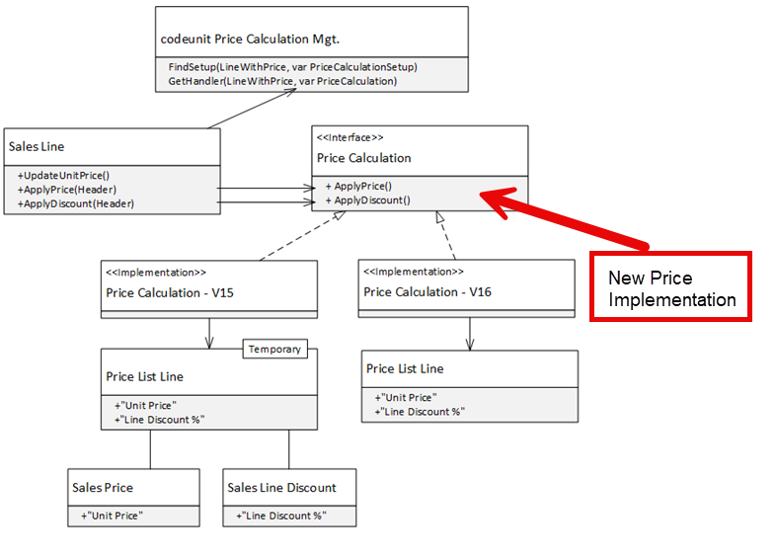
Sales Price Process
Interfaces Involved
Price Source Group
Price Calculation
Price Source
Price Asset
Line With Price
Benefits
No modifications to existing codeunits
Minimal subscribers needed
Source: https://learn.microsoft.com/en-us/dynamics365/business-central/dev-itpro/developer/devenv-extending-best-price-calculations
Notes:
JEFF
There are multiple interfaces at play in the price calculation engine

Slide 9
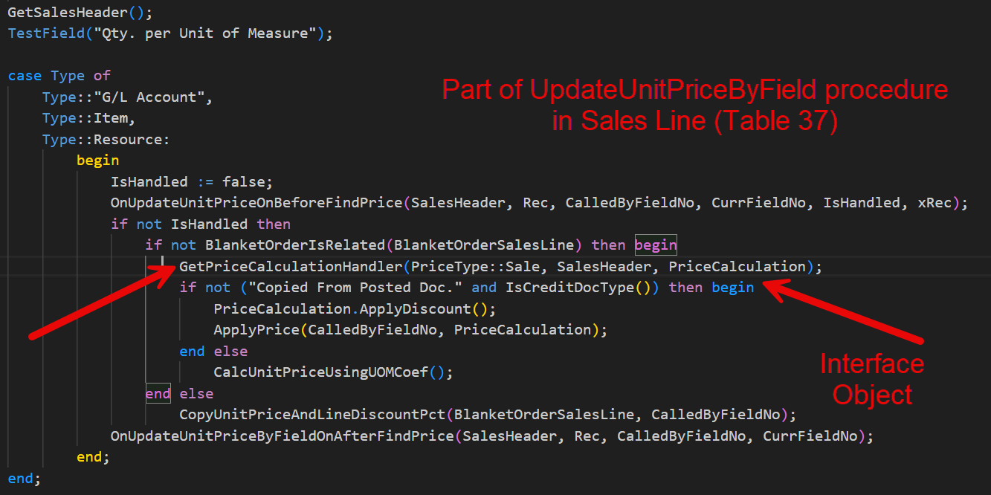
Where does it all start?
Notes:
JEFF
GetPriceCalculationhandler is used several times in the Sales Line Table
Followed by calls to various to use methods in the PriceCalculation

Slide 10
Key Steps to Modify Sales Price (Demo)
Extend the Price Calculation Method Enum.
Write Interface Handler
Hook calculation option up to handler
This will show it in the price method list
Implement/Update Price Calc. Buffer as needed
Implement Custom Logic in ApplyPrice
Notes:
JEFF
Extend the Price Calculation Method Enum. (Enum Ext. 50500)
Write Interface Handler (CDU 50500)
hook calculation option up to handler (Enum Ext. 50501)
This will show it in the price method list (in CDU 50500)
Implement/Update Price Calc. Buffer as needed (in CDU 50502)
Implement Custom Logic in ApplyPrice (in CDU 50500)
Remember to show what the “Interface looks like” drill through when in code

Slide 11
Sales Contract Price Demo
Notes:
JEFF

Slide 12
Base Apps interface implementation
When extending Retention Policies we can implement 3 interfaces:
Retention Period
Reten. Pol. Deleting
Reten. Pol. Filtering
Notes:
SILVIU
We discussed about one example of a completely new interface, the IProcessor interface for which we shown 3 codeunits that implement it.
We also saw how we can expand on existing in Base App interfaces via the sales pricing interface.
The next example is about leveraging Microsoft interfaces in System Application, more precisly about Retention Policies interfaces.

Slide 13
Retention Policy demo
Notes:
Demo:
Add custom table subject to retention policies (code needed)
Set it up (code sometimes needed)
Demo deletion of records from custom table.

Slide 14
Knowledge Check – Question 1
Changing the prototype of an interface method when implementing it leads to?
Runtime error
Compile error
Nuh, works fine
Notes:
Answer: B

Slide 15
Knowledge Check – Question 2
The interface itself doesn't contain any code, only signatures, and can't itself be called from code, but must be implemented by codeunits?
True
False
Notes:
Answer: A

Slide 16
Knowledge Check – Question 3
To implement an interface in AL you need to define?
Implementation codeunits
Report extensions
Enum to map records to codeunits
All of the above
A & C
Notes:
Answer: E

Slide 17
References & Links
Github Repositories
Sales Interface: https://github.com/JeffLandeen/2025Directions_SalesIFace
(Custom) Process Interface: https://github.com/SilviuVirlan/Directions2025
(Base App) Retention Policies Interfaces: SilviuVirlan/Directions2025InterfacesRetentionPoliciesCustomization
Blogs & Articles
Extending Best Price calculations (MS Learn): https://learn.microsoft.com/en-us/dynamics365/business-central/dev-itpro/developer/devenv-extending-best-price-calculations
Extending Sales Price Engine (Flemming Bakkensen): https://www.linkedin.com/pulse/how-extend-price-calculation-flemming-bakkensen-6tkgf/
Interfaces (MS Learn): https://learn.microsoft.com/en-us/dynamics365/business-central/dev-itpro/developer/devenv-interfaces-in-al
Kyle Hardens Days of Knowledge Examples: https://github.com/kylehardin7/DaysOfKnowledge

Slide 18

Thank You! https://github.com/JeffLandeen/2025Directions_SalesIFace
Notes:
https://github.com/JeffLandeen/2025Directions_SalesIFace

Slide 19
Interfaces in AL : Polymorphism
Polymorphism: write different code without changing the calling code.
Codeunit “Order Processor” Process() method creates Sales Orders;
Codeunit PartnerRateProcessor Process method creates Purchase Price List.
Notes:
Think the content of this slide can be discussed when the other slide is presented
Concerned about time

Slide 20
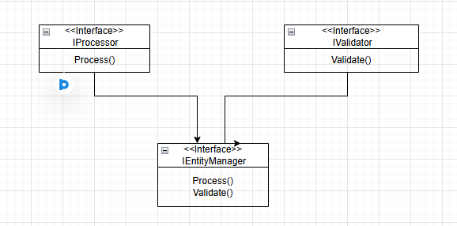
Interfaces in AL: Extending Interfaces
Extending interfaces: You can create new interfaces from existing ones.
Notes:
Is this covered elsewhere?
Can probably speak to this on one of the other slides to save time for demos

Slide 21
Interfaces in AL: Extending interfaces:
interface IProcessor
{
procedure Process(V: Variant): Boolean;
}
interface IValidator
{
procedure Validate(V: Variant): Boolean;
}
interface IEntityManager extends IProcessor, IValidator
{
procedure Process(V: Variant): Boolean;
procedure Validate(V: Variant): Boolean;
procedure GetEntity(V: Variant): Variant;
procedure SaveEntity(V: Variant): Boolean;
procedure DeleteEntity(V: Variant): Boolean;
}
codeunit OrderManagement implements IEntityManager
{
procedure Process(V: Variant): Boolean
...
procedure Validate(V: Variant): Boolean
...
procedure GetEntity(V: Variant): Variant
...
procedure SaveEntity(V: Variant): Boolean
...
procedure DeleteEntity(V: Variant): Boolean
...
}
Notes:
You can combine interfaces and implement the resulting interface

Slide 22
List of Interfaces (from runtime 15 BC 2025 wave 1)
Concept: Define an interface to handle multiple output channels
Use Case 1: Logging Messages
Log to console, file, or database using a unified interface
Example: ILogger implementations for each medium
Use Case 2: Social Media Posting
Post to X, Facebook, Instagram via a single IPost interface
Example: Loop through list to send to all platforms
Benefits:
Scalable: Add new media without changing core logic
Notes:
Think we should cut this slide to help save time for demos

Slide 23
List of Interfaces (from runtime 15 BC 2025 wave 1)
1. Define interface
2. Implement interface
3. Create List of Interfaces and loop through
interface Processor
{
procedure WriteMessage();
}
codeunit 70600 OrderProcessor implements Processor
{
procedure WriteMessage()
begin
Message('From Order Processor');
end;
}
pageextension 70600 CustomerListExt extends "Customer List"
{
trigger OnOpenPage();
var
lIface: List of [Interface Processor];
cuOrderProc: codeunit OrderProcessor;
cuRateProc: codeunit RateProcessor;
i: Interface Processor;
begin
lIface.Add(cuOrderProc);
lIface.Add(cuRateProc);
foreach i in lIface do begin
i.WriteMessage();
end;
end;
}
codeunit 70601 RateProcessor implements Processor
{
procedure WriteMessage()
begin
Message('From Rate Processor');
end;
}
Notes:
SILVIU

